Slide 1
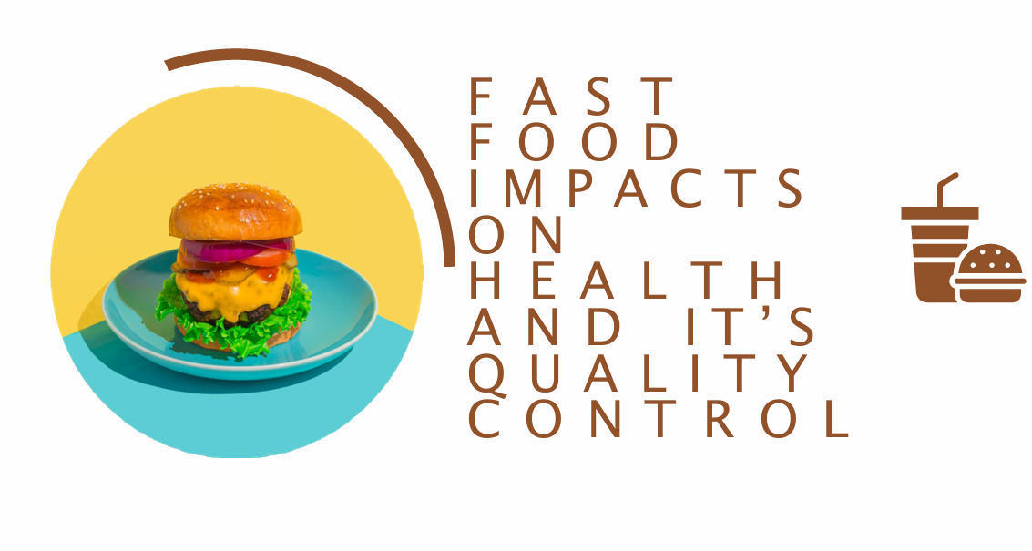

Slide 2
Introduction:
In recent decades, fast food has become a prominent feature of modern life due to its convenience, affordability, and widespread availability.
Fast food is typically high in calories, fats, sugars, and salt, while often lacking essential nutrients such as vitamins, minerals, and fiber. These dietary patterns have been associated with a range of health issues, including obesity, diabetes, cardiovascular diseases, and other chronic conditions.
Quality control in the fast food industry ensures that products meet safety, hygiene, and nutritional standards.
This project aims to contribute to this understanding by offering a detailed exploration of fast food consumption patterns, health impacts, quality perceptions, and consumer awareness in the Indian context.
By focusing on populations from Malappuram and Calicut, and combining both youth and older adult perspectives, the study offers a rich and nuanced view of this growing phenomenon.

Slide 3
Objectives of the study
To compare the trends of Fast Food consumption across different demographic variables.
To find out the reasons for the consumption of Fast Food among different categories.
To find out which is the most preferred time and most preferred Fast Food among People.
To find out an average amount of money that People spend on Fast Food.
To assess the awareness and impact of health risks associated with fast food consumption.
To evaluate satisfaction levels of people.
To explore the relationship between Body Mass Index (BMI) and fast food consumption.
Examine how external influences like social media affect fast food choices.
Understand how often people monitor their calorie\nutritional intake and its relationship with other factors.
Foodborne illness and health impacts.
Consumer satisfaction with fast food quality.

Slide 4
Methodology
Primary Data: A survey questionnaire was designed to gather responses on fast food consumption frequency, preferences, and associated health-related factors.
Sampling Method: A convenience sampling technique was used to ensure a representative sample of the target population.
Sample Size: The study includes 408 younger adults and 50 older adults, with participants from Malappuram and Calicut.
Data analysis was conducted using SPSS, R, Microsoft Excel and Power BI.
Participants’ responses were collected anonymously to ensure privacy.
The study was conducted with informed consent from all respondents
Data Collection
Software Used
Ethical Considerations

Slide 5
Statistical Analysis
The data were analyzed using various statistical techniques to explore relationships, trends, and patterns:
Descriptive Statistics: Used to summarize respondents' demographic profiles and fast food consumption habits.
Inferential Statistics:
Crosstabs: To examine the distribution of categorical variables.
Correlation Analysis (Pearson Correlation): To assess relationships between numerical variables.
Median Test: To compare the medians of two or more independent groups.
Multiple Response Frequency Analysis: To analyze responses for multiple-choice questions.
Principal Component Analysis (PCA) & Factor Analysis: To reduce data dimensions and identify key underlying factors.
Multinomial Regression Model: To predict categorical outcomes with multiple response categories.
Ranking Analysis: To assess the relative importance of various factors.
Kruskal-Wallis Test: To compare medians across multiple independent groups.
T-Test: To compare means between two groups.
Logistic Regression: To predict binary health outcomes based on fast food consumption.
Welch ANOVA: To compare means when variances are unequal across groups.
Multiple Correspondence Analysis (MCA): To explore associations among categorical variables.
Mann-Whitney U Test: To compare distributions between two independent groups.

Slide 6
CHAPTER 1
Fast Food Consumption Patterns Across Demographics

Slide 7
To compare the trends of Fast Food consumption accross different demographic variables
Cross-tabulation with standardized residuals
(to identify which specific demographic groups deviate from expected patterns)

Slide 8
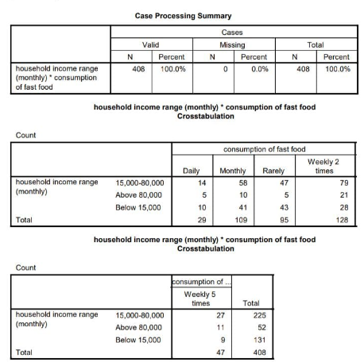
Household income range(monthly) vs fastfood consumption
Conclusion:
The chi-square statistic obtained was 16.74, with a p-value of 0.032. Since the p-value is less than 0.05, we reject the null hypothesis, indicating that there is a statistically significant association between household income and fast food consumption.
These findings suggest that middle-income individuals (15,000–80,000) tend to consume fast food more frequently compared to lower and higher-income groups, which is statistically significant.

Slide 9
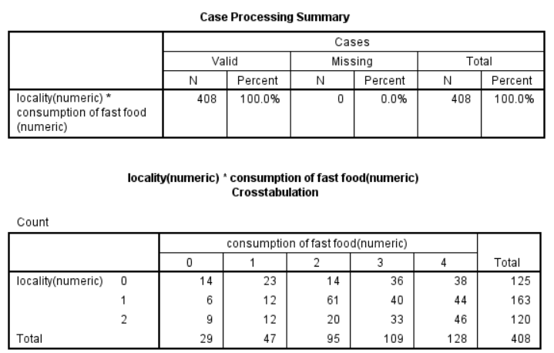
Locality vs fastfood consumption
Conclusion:
The chi-square statistic obtained was 21.52, with a p-value of 0.018.Since the p-value is less than 0.05, the result is statistically significant, indicating that health issues due to fast food consumption vary based on locality.
These findings suggest that fast food consumption is associated with notable health impacts across all localities, with rural areas showing higher digestive issues and weight-related problems.

Slide 10
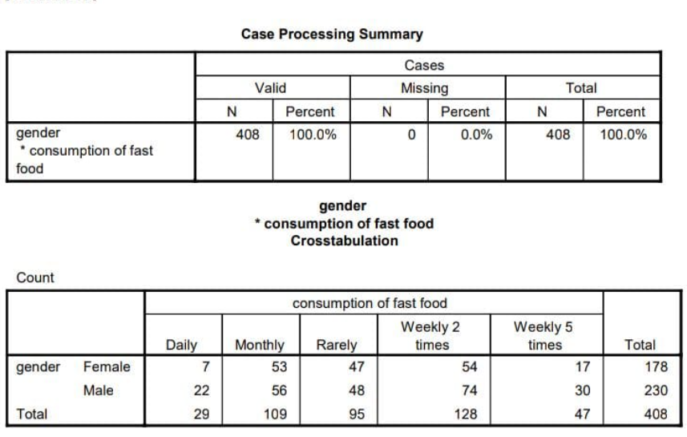
Gender vs fastfood consumption
Conclusion:
The chi-square statistic obtained was 8.08 with a p-value of 0.0888.Since the p-value is greater than 0.05, we fail to reject the null hypothesis, indicating that there is no significant association between gender and fast food consumption.
Overall, males tend to consume fast food more frequently than females, but the difference is not statistically significant based on the chi-square test results.

Slide 11
Comparing Fast Food Consumption Trends Across Demographics -(old age)
Cross-tabulations and Chi-square tests
ANOVA or t-tests
Descriptive statistics with visualization

Slide 12
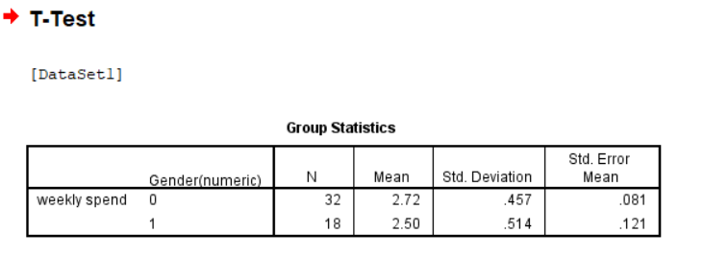
Comparison of Weekly Spending by Gender
Gender 0 (Female): N=32, Mean weekly spend = 2.72, Std. Dev = 0.457
Gender 1 (Male): N=18, Mean weekly spend = 2.50, Std. Dev = 0.514
The means suggest that females (0) spend slightly more per week than males (1).
1. Group Statistics Table

Slide 13
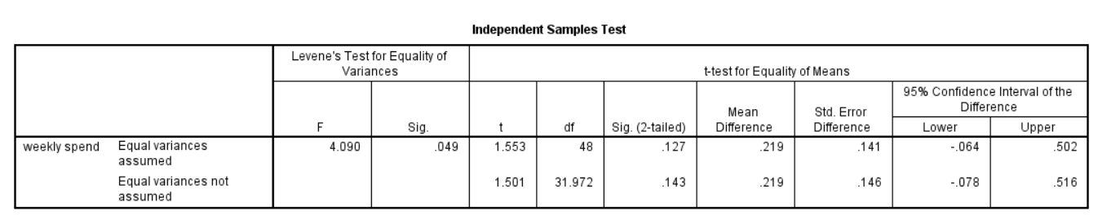
2. Levene's Test for Equality of Variances
Levene’s F = 4.090, Sig. = 0.049
Since 0.049 < 0.05, we reject the null hypothesis of equal variances → Use the "Equal variances not assumed" row in the t-test.
3. Independent Samples t-test
Sig. (2-tailed) = 0.143 (> 0.05) → Not significant
95% CI: [-0.078, 0.516] (includes zero)
Conclusion : Since p = 0.143, there is no significant difference in weekly spending between males and females.

Slide 14
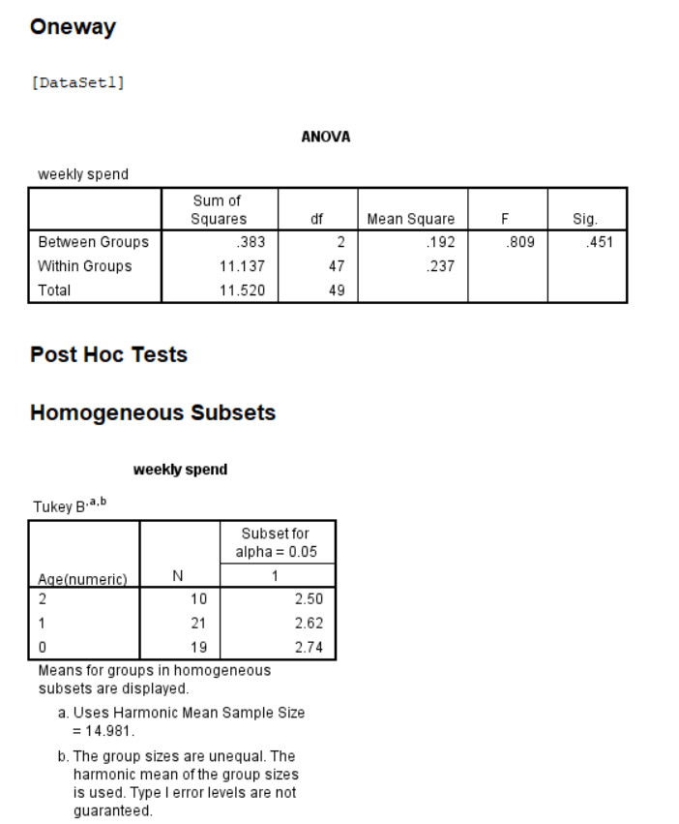
Analysis of Weekly Spending Across Age Groups
No significant difference in weekly spending across age groups (F = 0.809, p = 0.451).
Post Hoc (Tukey’s Test) Results:
The three age groups analyzed:
40-50 years (Code 0) → Mean: 2.74
50-60 years (Code 1) → Mean: 2.62
60+ years (Code 2) → Mean: 2.50
Conclusion
No significant subgroup differences detected, as all means fall within the same homogeneous subset.

Slide 15
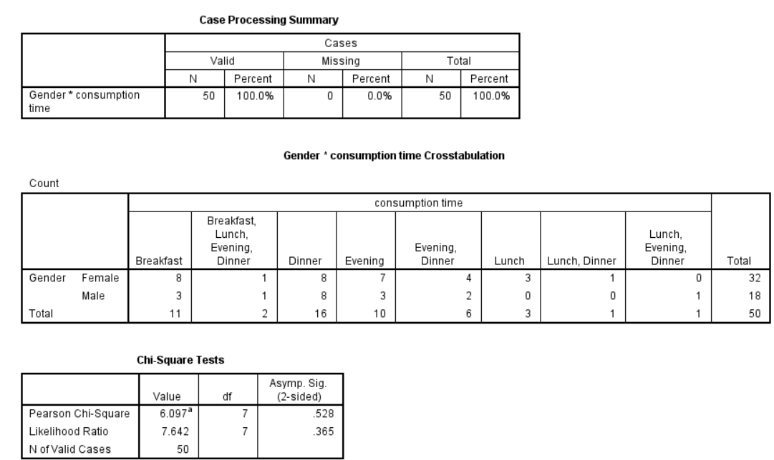
2.Crosstabulation (Gender vs. Consumption Time)
1.Case Processing Summary
The dataset consists of 50 valid cases, with no missing values.
The table shows the distribution of meal consumption times based on gender.
Females (N = 32) are more distributed across different consumption times than males (N = 18).
The most common consumption times for females are Breakfast (8) and Evening (7).
For males, Dinner (8) and Evening, Dinner (3) are more frequent.

Slide 16
3.Chi-Square Test Results
Pearson Chi-Square Value = 6.097, df = 7, p-value = 0.528
Likelihood Ratio = 7.642, df = 7, p-value = 0.365
Since p > 0.05, there is no significant relationship between gender and consumption time.
Interpretation:
There is no statistically significant association between gender and food consumption time, meaning that meal timing preferences do not significantly differ between males and females in this dataset.

Slide 17
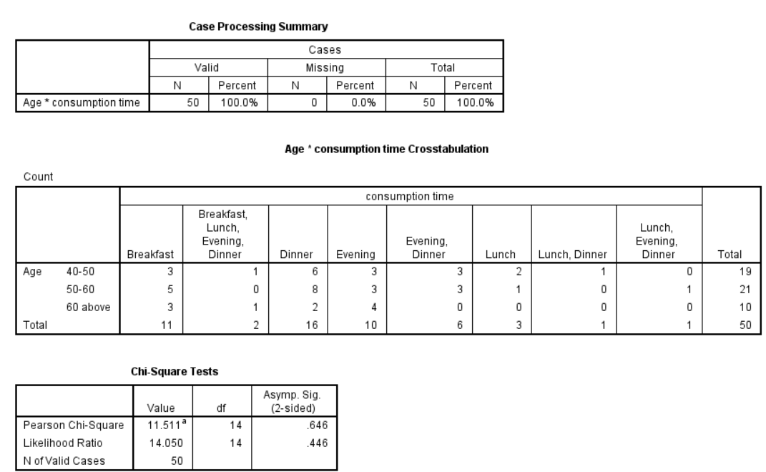
2. Cross-tabulation (Age vs. Consumption Time)
1. Case Processing Summary
The dataset includes 50 valid cases with no missing values.
The table shows how different age groups (40-50, 50-60, and 60 above) distribute across meal consumption times.
Age 40-50 (N = 19):
Most common consumption times: Dinner (6) and Evening, Dinner (3).
Age 50-60 (N = 21):
Most common: Dinner (8) and Evening, Dinner (3).
Age 60 above (N = 10):
Most common: Evening (4) and Dinner (2).

Slide 18
3. Chi-Square Test Results
Pearson Chi-Square Value = 11.511, df = 14, p-value = 0.646
Likelihood Ratio = 14.050, df = 14, p-value = 0.446
Since p > 0.05, there is no statistically significant relationship between age and meal consumption time.
Interpretation:
The data suggests that age does not significantly influence meal consumption time in this sample. Eating habits appear relatively similar across age groups.

Slide 19
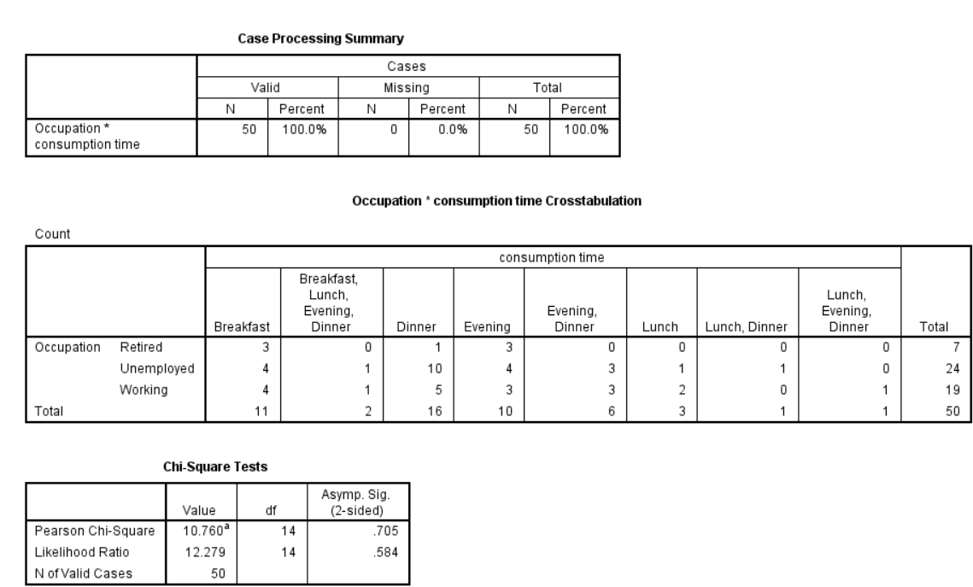
2. Cross-tabulation (Occupation vs. Consumption Time)
1. Case Processing Summary
Total cases: 50,Valid cases: 50 (100%),Missing cases: 0 (0%)
The table shows how meal consumption time varies by occupation (Retired, Unemployed, Working).
Retired (N = 7):
Most common meal consumption times: Evening (3) and Breakfast (3).
Unemployed (N = 24):
Most common: Dinner (10) and Evening (4).
Working (N = 19):
Most common: Dinner (5) and Evening, Dinner (3).

Slide 20
3. Chi-Square Test Results
Pearson Chi-Square Value: 10.760, df: 14, p-value: 0.705
Likelihood Ratio: 12.279, df: 14, p-value: 0.584
Since p > 0.05, there is no statistically significant relationship between occupation and meal consumption time.
Interpretation:
Meal consumption time does not significantly differ based on occupation in this dataset. The distribution of meal times across different occupations appears random.

Slide 21
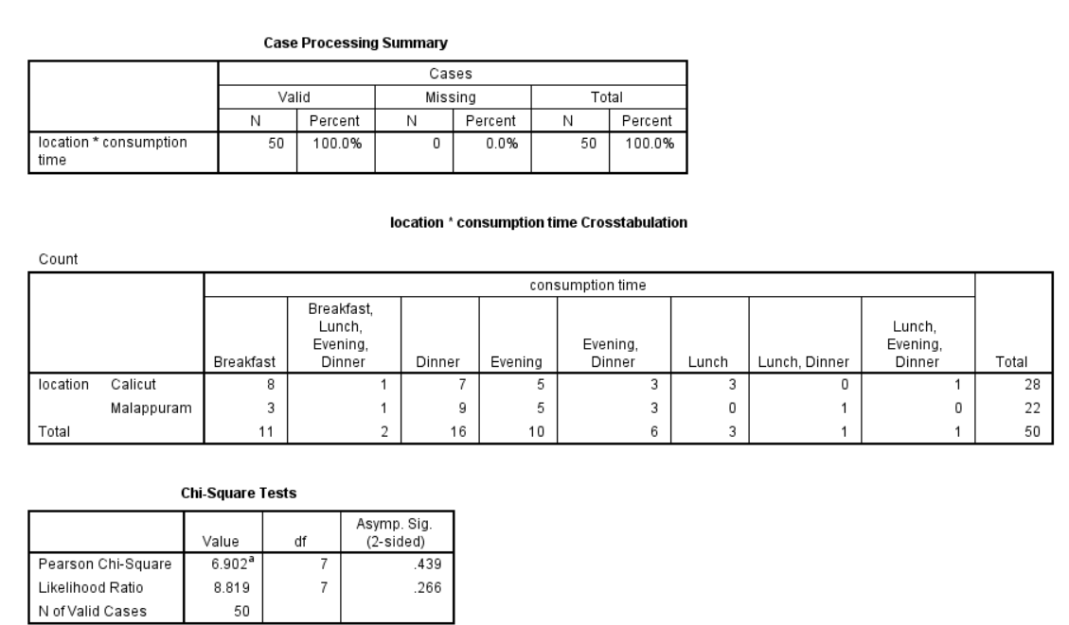
2. Cross-tabulation (Location vs. Consumption Time)
1.Case Processing Summary
Total cases: 50
Valid cases: 50 (100%)
Missing cases: 0 (0%)
The table compares meal consumption time across two locations: Calicut and Malappuram.
Calicut (N = 28):
Most common meal times: Breakfast (8), Dinner (7), and Evening (5).
Malappuram (N = 22):
Most common meal times: Dinner (9) and Evening (5).

Slide 22
3. Chi-Square Test Results
Pearson Chi-Square Value: 6.902, df: 7, p-value: 0.439
Likelihood Ratio: 8.819, df: 7, p-value: 0.266
Since p > 0.05, there is no statistically significant relationship between location and meal consumption time.
Interpretation:
Meal consumption time does not significantly differ between Calicut and Malappuram. The distribution of meal times across the two locations appears to be similar.

Slide 23
CHAPTER 2
Motivations, Preferences, and Spending Behaviors

Slide 24
To find out the reasons for the consumption of Fast Food among different categories
Multiple response frequency analysis
(for motivating factors)
Multinomial Logistic regression
(with motivational factors as dependent variables and demographics as predictors)

Slide 25
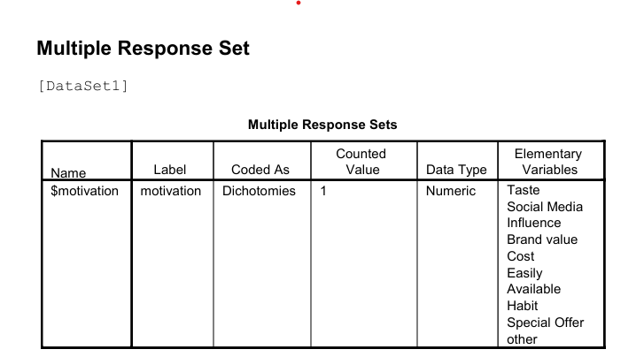
Multiple response frequency analysis
This analysis examines motivational factors influencing consumer choices using a multiple response dataset with 408 valid respondents (100% response rate). The study focuses on understanding what motivates consumers to make purchasing decisions.

Slide 26
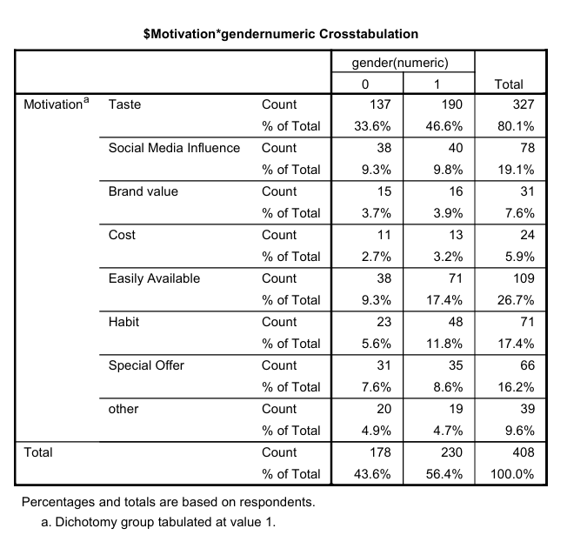
Motivational Factors by Gender
The data coded gender as 0 and 1, with:
0=“Female”,1=“Male”
Female: 43.6% of respondents
Male: 56.4% of respondents
Key gender-based observations:
Taste is important across genders but more prevalent in Male (46.6% vs 33.6%)
Easily Available shows a notable difference between genders (17.4% for Male vs 9.3% for Female)
Habit is mentioned more by Male (11.8% vs 5.6%)
Social Media Influence is relatively consistent between genders (9.8% vs 9.3%)
Special Offer and Other factors show minimal gender differences

Slide 27
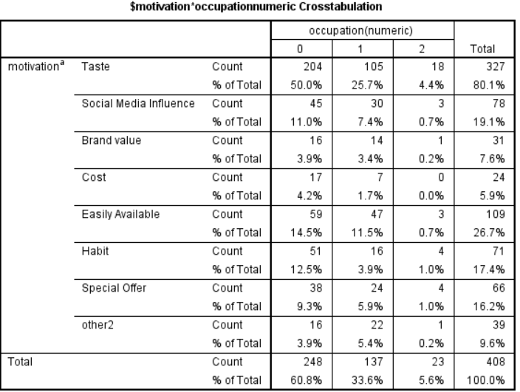
Motivational Factors by Occupation
Occupation was categorized into 3 groups (0-2):
0=“students” ,1=“working” ,2=“unemployed” ,
Students: 60.8% of respondents (majority)
Working: 33.6% of respondents
Unemployed: 5.6 % of respondents
Key occupation-based observations:
Taste is important across all occupations but most prevalent in Students(50.0%)
Habit shows notable variation between Students(12.5%) and Working(3.9%)
Easily Available is relatively important across Students(14.5%) and Working (11.5%)
Unemployed have limited representation in the sample, making their specific trends less reliable.

Slide 28
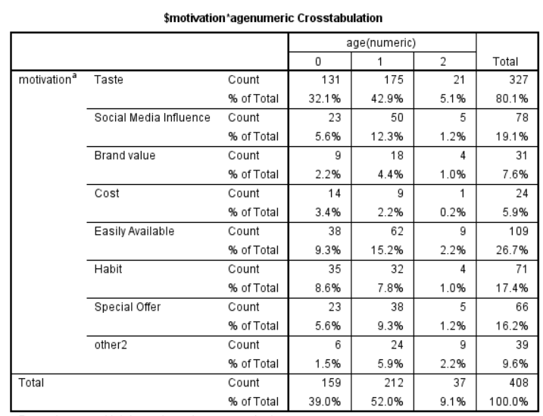
Motivational Factors by Age
Age was categorized into 3 groups (0-2):
0=10-20 1=21-30 2=31-40
10-20 age: 39.0% of respondents
21-30 age: 52.0% of respondents (majority)
31-40 age: 9.1% of respondents
Key age-based observations:
Taste is most important for age 21-30 (42.9%)
Social Media Influence is a highest in age 21-30 (12.3%)
Easily Available is a also highest in age 21-30 (15.2%)
Habit is more important for age 10-20 (8.6%) than age 21-30 (7.8%)

Slide 29
Multinomial Logistic regression
To understand the relationship between different factors (gender, age, income, district, and locality) and the reason for choosing FAST FOOD
Model Fit Statistics
Residual Deviance = 2482.395, AIC = 2608.395
Lower AIC indicates a better model fit.
Key Findings:
Gender: Males are more likely to choose "Habit" (OR = 1.95) and "Taste" (OR = 1.38).
Age:
21-30 years → Less likely to pick "Cost" (-1.07) & "Habit" (-0.74).
31-40 years → More likely to choose "Other" reasons (1.22).
Income:
Higher-income individuals (>80,000 INR) are less likely to choose cost-related reasons (-0.54).
District: Respondents from Malappuram are less likely to choose "Cost" (-0.14) and "Easily Available" (-0.36).
Locality:
Urban consumers are less likely to pick "Cost" (-1.41) and "Taste" (-1.68).
Semi-urban consumers also show similar trends (-1.96 for "Cost").

Slide 30
Statistical Significance (P-Values)
Taste (p = 5.79e-08) and Easily Available (p = 0.001) are highly significant.
Urban consumers show significant preference differences (p < 0.05).
Key Insights
Taste is the dominant factor in product choice.
Higher-income groups prioritize factors other than cost.
Urban & semi-urban consumers are less influenced by cost and habit.
Males are more influenced by "Habit" than females.
Young adults (21-30 years) care less about cost.

Slide 31
Reasons for Fast Food Consumption Among Different Categories(old age)
Factor Analysis - To identify underlying patterns in motivations for consumption
Multiple Correspondence Analysis (MCA) - To visualize associations between categorical variables like:
Motivations for consumption and demographic variables.
Chi-square tests - To determine if specific reasons for consumption (taste, socializing, convenience) are significantly associated with demographic variables

Slide 32
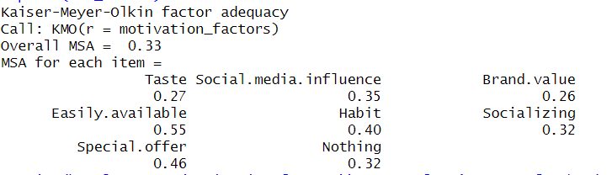
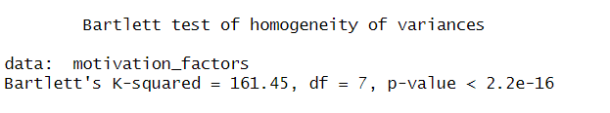
Factor Analysis
Factor Analysis was conducted to identify the underlying motivational factors driving fast food consumption among different categories.
The Kaiser-Meyer-Olkin (KMO) Measure of Sampling Adequacy was 0.33, indicating that the dataset may not be highly suitable for factor analysis.
Bartlett’s test was significant (p < 0.001), suggesting that the variables are correlated enough for factor extraction.

Slide 33
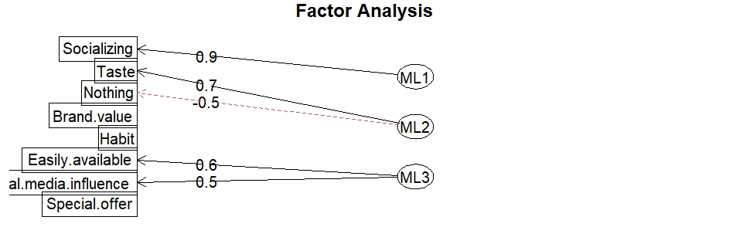
Using Maximum Likelihood Estimation (ML) with Varimax Rotation, three key factors were identified:
Social and Emotional Influence (Factor 1 - ML1)
High positive loading on:
Socializing (0.950) → Social interactions are a strong motivation for consuming fast food.
Taste (-0.624) → Interestingly, taste has a negative loading, suggesting that those motivated by socializing may not prioritize taste.
Interpretation: Individuals who consume fast food for social reasons (gatherings, events, peer influence) are strongly represented in this factor.
Negative loading on:
Nothing (-0.522) → Suggests that individuals motivated by taste and habit do not consume fast food for no specific reason.
Interpretation:
This factor indicates that brand perception and established habits play a significant role in consumption decisions
The negative loading for "Nothing" suggests that purposeful choice is important
Brand and Habitual Preference (Factor 2 - ML2)
Positive loading on:
Brand value (0.7): Strong positive influence
Habit (0.6): Moderate influence

Slide 34
Convenience and Promotions (Factor 3 - ML3)
High positive loading on:
Easily Available (0.610) → Accessibility is a significant motivator.
Social Media Influence (0.499) → Social media plays a role in decision-making.
Interpretation: This factor represents convenience-driven consumers who prefer fast food because it is readily available and influenced by social media promotions.
Conclusion:
Social interactions, taste & habit, and convenience are the three primary motivations for fast food consumption in old age category.

Slide 35
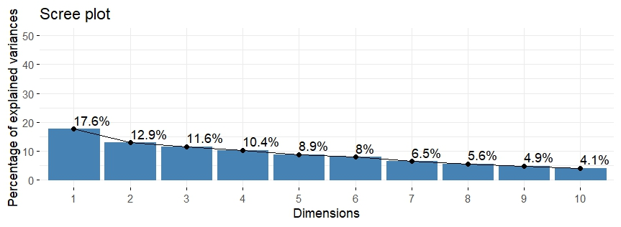
Multiple Correspondence Analysis (MCA)
This MCA results provide insights into the associations between categorical variables, particularly motivation factors and demographic characteristics of respondents
Scree Plot Interpretation :
The scree plot indicates the percentage of variance explained by each dimension.
Dim1 (17.6%) and Dim2 (12.9%) together account for 30.5% of the variance in the dataset.
This suggests that while the first two dimensions capture a significant portion of the variability, additional dimensions may also be relevant.

Slide 36
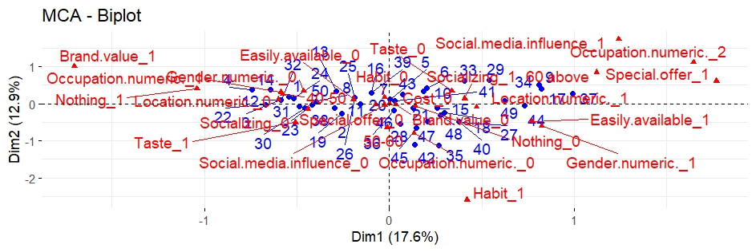
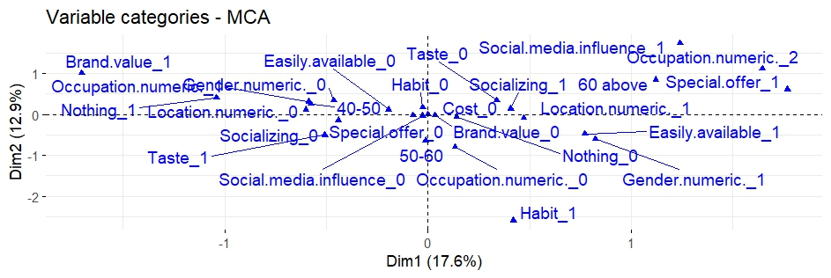
Biplot Interpretation (MCA Biplot)
The biplot shows the relationship between different motivation factors and demographic variables.
"Brand value" and "Occupation_numeric_2" appear to be related.
"Taste" and "Habit" are located close to each other, suggesting they may be linked.
"Nothing" (indicating no particular motivation) appears near "Location_numeric_0", meaning respondents in this demographic category may not have strong motivational factors.
Variable Categories Plot (Associations)
This plot focuses on how categorical variable levels contribute to the MCA dimensions.
Key observations:
"Special.offer_1" is strongly associated with certain demographic groups.
"Easily.available_1" (importance of availability) is associated with some specific occupation groups.
"Social.media.influence_1" is closer to a different set of demographic variables, indicating it is relevant only to certain individuals.

Slide 37
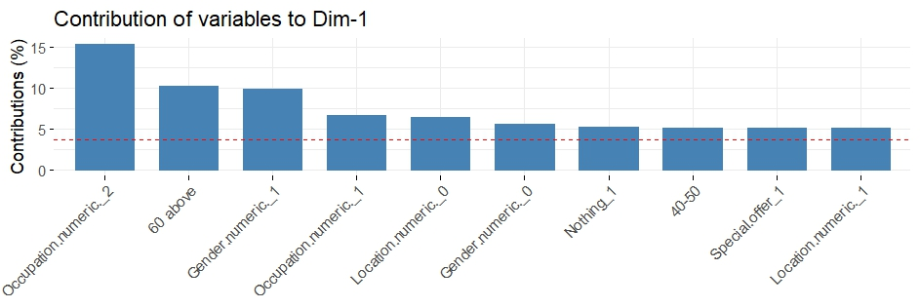
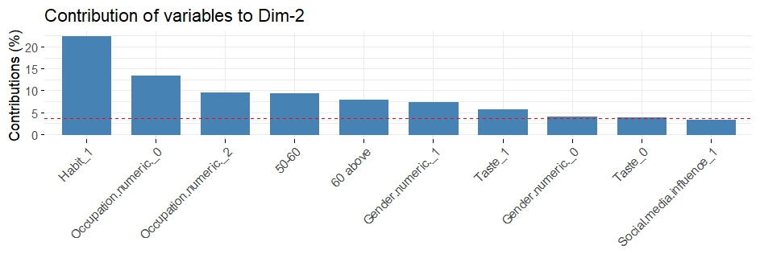
Contribution of Variables to Dimensions
The bar plots show how much each variable contributes to Dim1 and Dim2.
Dim1 (17.6%):
Top contributors: Occupation (numeric), Age (60 above), Gender (numeric).
Interpretation: Occupational status and age play a key role in differentiating motivation factors.
Dim2 (12.9%):
Top contributors: Habit, Occupation (numeric), Social media influence.
Interpretation: Personal habits and the influence of social media distinguish different groups.

Slide 38
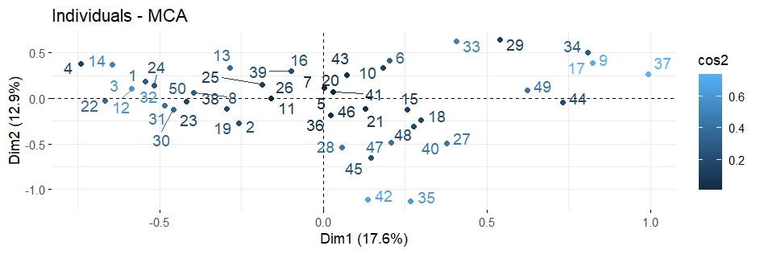
Individual Plot (Respondent Positioning)
The individuals' MCA plot shows how different respondents are positioned based on their responses.
Darker points indicate individuals who are well represented by the dimensions.
Individuals closer to a particular category are more strongly associated with it.
Key Takeaways:
Occupation, age, and gender significantly influence motivation factors.
Taste, brand value, and habit appear to be key motivators for older individuals.
Younger respondents or certain occupations are more likely to be influenced by special offers or social media.
Easily Available of fast food plays a crucial role for certain demographics.

Slide 39
Chi-Square Test
This test analyzes the relationship between age and reasons for consuming fast food using chi-square tests.
Factors Considered: The study examines various reasons for consuming fast food, such as taste, social media influence, brand value, cost, availability, habit, socializing, special offers, and having no specific reason.
Chi-Square Test Results:
Taste: No significant relationship between age and preference for taste (p = .331).
Social Media Influence: No significant relationship (p = .435).
Brand Value: No significant relationship (p = .435).
Cost: No chi-square statistics were computed as cost was a constant.
Availability: No significant relationship (p = .362).
Habit: No significant relationship (p = .572).
Socializing: No significant relationship (p = .360).
Special Offers: A significant relationship was found (p = .016), meaning age might influence the likelihood of choosing fast food due to special offers.
No Specific Reason: No significant relationship (p = .811).
Interpretation:
Most reasons for fast food consumption (e.g., taste, branding, and habit) do not significantly vary by age.
However, special offers appear to be a more significant motivator for certain age groups.

Slide 40
To find out which is the most preferred Fast Food among People
Multiple response frequency analysis
(for food preferences)
Ranking analysis
(to determine overall popularity)

Slide 41
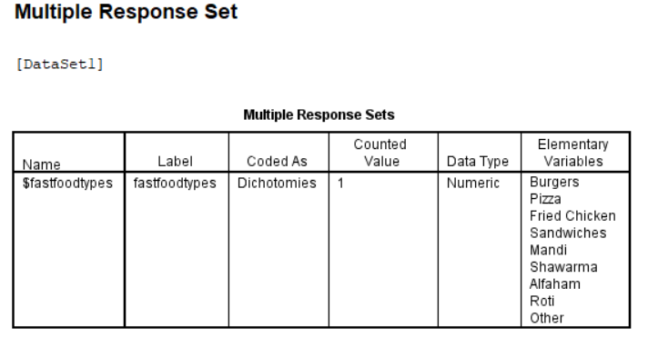
Multiple response frequency analysis
This analysis examines consumer preferences for different types of fast food items using a multiple response dataset.

Slide 42
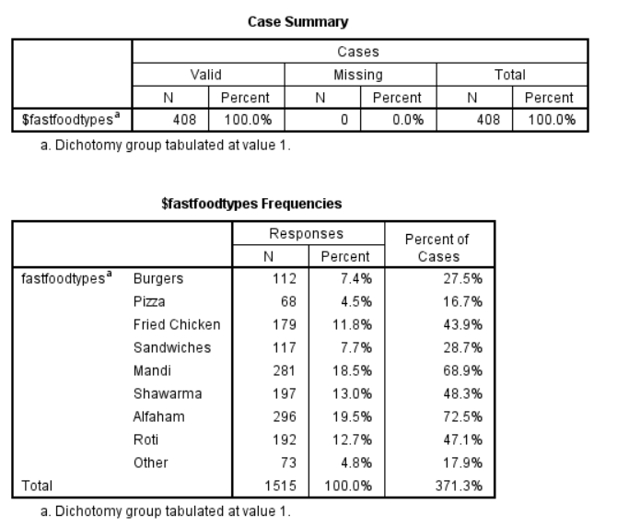
Key Insights:
Alfaham Dominates: 72.5% choose alfaham when getting fast food, making it the clear favourite.
Middle Eastern Food Influence: Traditional items like Mandi (68.9%) and Shawarma (48.3%) are extremely popular, even more than Western options.
People Like Variety: The average person selected nearly 4 different types of fast food they enjoy, showing people aren't loyal to just one type.
Western Fast Food Takes a Back Seat: Despite their global popularity, burgers (27.5%) and pizza (16.7%) are much less popular than other options in this survey.
Regional Tastes Matter: The strong preference for Mandi, Shawarma, and Roti suggests this survey likely took place in a region with Middle Eastern or South Asian influences.

Slide 43
Summary:
This survey shows that when it comes to fast food preferences, Alfaham and Middle Eastern/Indian options are far more popular than traditional Western fast food like burgers and pizza.
Most people enjoy multiple types of fast food rather than sticking to just one category.

Slide 44
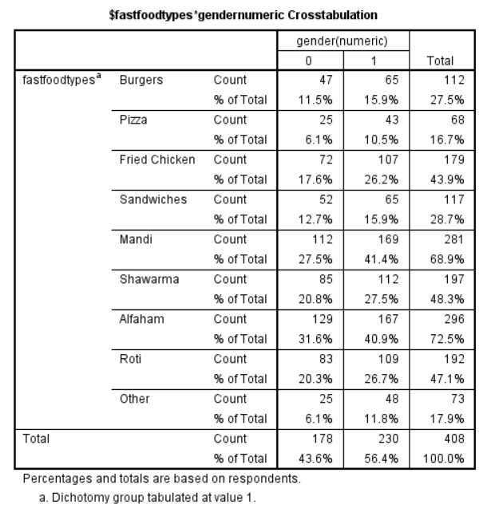
Fast food types by Gender
The sample was divided into two gender categories:
Where 0 denote “Female” and 1 denote “Male”
Female: 43.6% of respondents
Male: 56.4% of respondents
Key gender-based findings:
Male consistently showed higher preferences across all fast food types
Largest gender differences were observed in:
Mandi (41.4% for Male vs. 27.5% for Female)
Alfaham (40.9% for Male vs. 31.6% for Female)
Smallest gender differences were in:
Sandwiches (15.9% for Male vs. 12.7% for Female)
Burgers (15.9% for Male vs. 11.5% for Female)

Slide 45
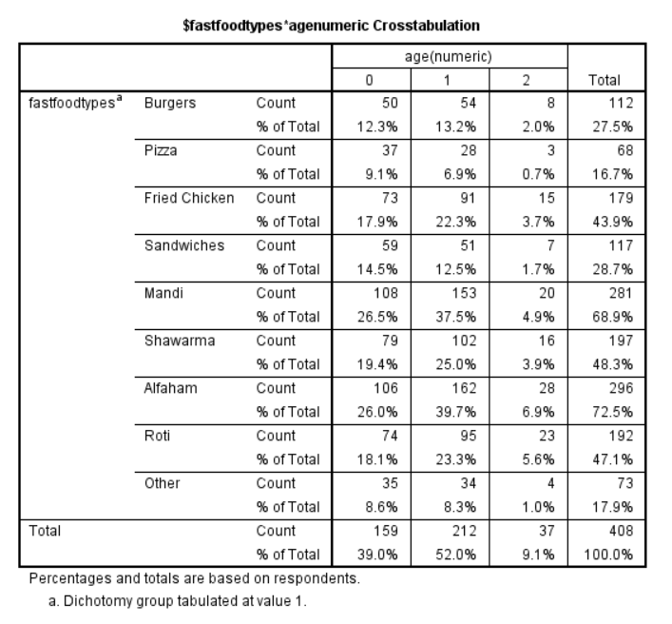
Fast food types by Age
The sample was divided into four age groups:
Age group 0 represents 10-20, 1 represents 21-30,
2 represents 31-40
10-20 Age group : 39.0% of respondents
21-30 Age group : 52.0% of respondents (largest group)
31-40 Age group : 9.1% of respondents
Key age-based findings:
21-30 Age group showed the highest preference for:
Alfaham (39.7%)
Mandi (37.5%)
Shawarma (25.0%)
10-20 Age group preferred:
Pizza (9.1% vs. 6.9% for Age group 1)
Sandwiches (14.5% vs. 12.5% for Age group 1)
31-40 Age group showed relatively higher preference for Roti and Alfaham compared to other fast food types

Slide 46
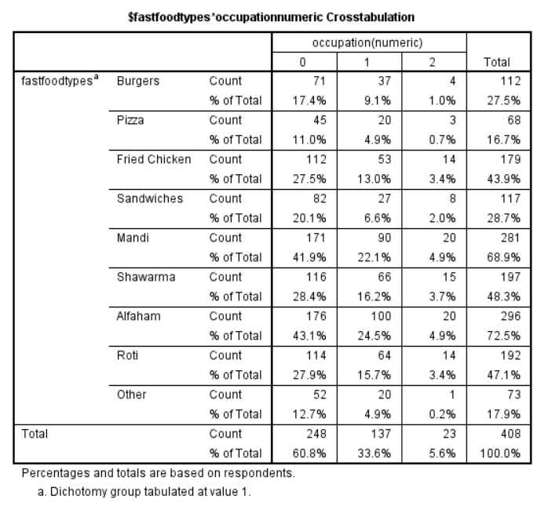
Fast food types by Occupation
The sample was divided into four occupation categories:
0=“students” ,1=“working” ,2=“unemployed” ,
Students: 60.8% of respondents (majority)
Working: 33.6% of respondents
Unemployed: 5.6% of respondents
Key occupation-based findings:
Students showed the highest preference across all fast food types
Most popular items for Occupation 0 were:
Alfaham (43.1%)
Mandi (41.9%)
Shawarma (28.4%)
Roti (27.9%)
Working people showed similar preference patterns but at lower percentages
Unemployed people had too few respondents for reliable conclusions

Slide 47
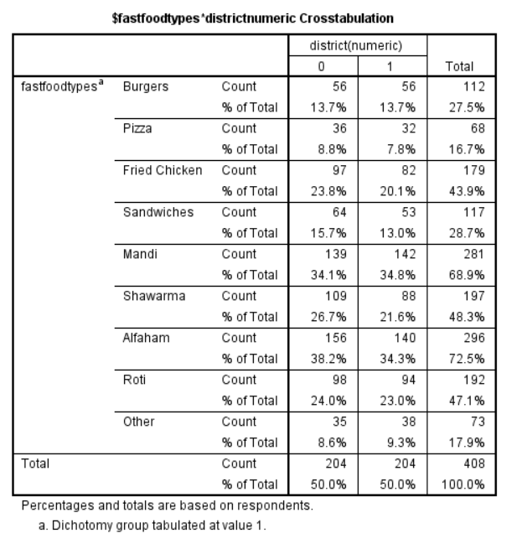
Fast food types by District
The sample was divided into two district categories:
0= “Malappuram” 1=“ Calicut”
District 0: 50.0% of respondents
District 1: 50.0% of respondents
Key district-based findings:
Nearly equal representation between districts
Malappuram showed higher preferences for:
Alfaham (38.2% vs. 34.3% for Calicut )
Shawarma (26.7% vs. 21.6% for Calicut)
Fried Chicken (23.8% vs. 20.1% for Calicut)
Calicut showed higher preference for Mandi (34.8% vs. 34.1% for Malappuram )
Burgers showed equal preference across districts (13.7% each)

Slide 48

Fast food types by Locality
The sample was divided into three locality types:
0=“Urban” 1=“Rural” 2=“Semi-Urban
Urban: 30.6% of respondents
Rural: 40.0% of respondents (largest group)
Semi-Urban: 29.4% of respondents
Key locality-based findings:
Rural showed the highest preference across all fast food types
Most significant locality differences were in:
Alfaham (28.9% for Rural vs. 21.1%
for Urban and 22.5% for Semi-Urban)
Fried Chicken (17.4% for Rural vs. 11.8%
for Urban and 14.7% for Semi-Urban)
Semi-Urban showed relatively higher preference for Fried Chicken compared to Urban

Slide 49
Ranking analysis
(to determine overall popularity)
Food Type | Frequency | Percentage(%) | Rank
Alfaham | 296 | 19.5 | 1
Mandi | 281 | 18.5 | 2
Shawarma | 197 | 13.0 | 3
Roti | 192 | 12.7 | 4
Fried Chicken | 179 | 11.8 | 5
Sandwiches | 117 | 7.7 | 6
Burgers | 112 | 7.4 | 7
Other | 73 | 4.8 | 8
pizza | 68 | 4.5 | 9
Key Observations:
Alfaham (296 responses, 19.5%) holds the top position, indicating it's the most preferred fast food choice and Pizza (68 responses, 4.5%) holds the lowest ranked among all fast food types
Cultural Preferences: Middle Eastern/South Asian food items (Mandi, Shawarma, Roti) collectively dominate the preferences, representing 44.2% of all responses.
Chicken Popularity: Chicken-based items (Alfaham, Fried Chicken) collectively represent 31% of preferences, showing strong preference.
Western vs. Regional Foods: Traditional Western fast foods (Pizza, Burgers, Sandwiches) collectively represent only 19.6% of preferences, significantly less than regional specialties.

Slide 50
To find out which is the most preferred time for the consumption of Fast Food among People.
Frequency analysis
( of consumption times)
Cross-tabulation
( of time preferences with demographic variables)

Slide 51
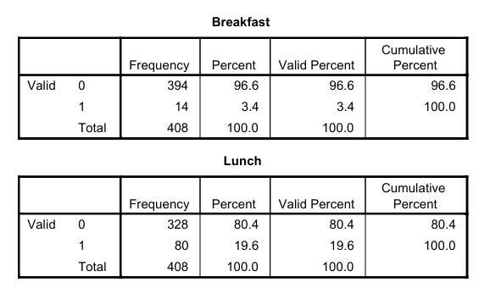
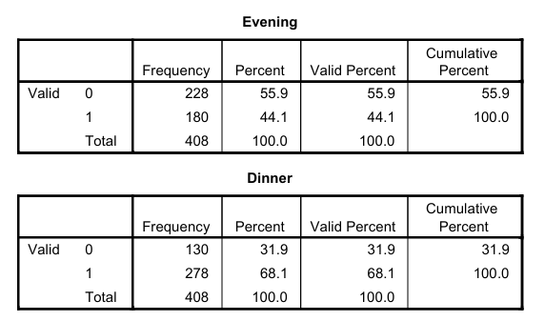
FREQUENCY ANALYSIS
Detailed Frequency Analysis by Meal Time
Breakfast
Only 14 respondents (3.4%) consume fast food during breakfast,
394 respondents (96.6%) do not consume fast food during breakfast.
Clearly the least preferred time for fast food consumption is morning.
Lunch
80 respondents (19.6%) consume fast food during lunch,
328 respondents (80.4%) do not consume fast food during lunch.
Lunch time represents a modest portion of fast food consumption.
Evening
180 respondents (44.1%) consume fast food during evening,
228 respondents (55.9%) do not consume fast food during evening.
It shows significant popularity, particularly as a snack or
pre-dinner option.
Dinner
278 respondents (68.1%) consume fast food during dinner,
130 respondents (31.9%) do not consume fast food during dinner.
Clearly the most preferred fast food consumption time is dinner.

Slide 52
Key Insights:
Strong Dinner Preference: Over two-thirds of respondents consume fast food during dinner, making it the dominant meal time for fast food consumption.
Evening as Secondary Choice: Nearly half of the respondents consume fast food during evening hours, suggesting significant demand for fast food as a snack or early dinner option.
Limited Breakfast Market: The extremely low preference for fast food during breakfast (3.4%) indicates a minimal market for breakfast-focused fast food options in this population.

Slide 53
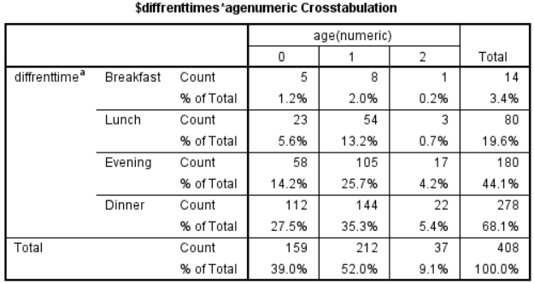
Different times by Age
0 represents 10-20, 1 represents 21-30, 2 represents 31-40
10-20 Age group : 159 respondents (39.0%)
21-30 Age group : 212 respondents (52.0%) - largest group
31-40 Age group : 37 respondents (9.1%)
Age-Based Patterns:
21-30 Age group (likely young adults) shows the highest preference for evening and Dinner fast food.
10-20 Age group shows the highest relative preference for dinner fast food.
31-40 Age group shows a preference for dinner, though the sample size is small.

Slide 54
To find out an average amount of money that People spend on Fast Food.
Descriptive statistics (mean, median, mode)
(for spending per meal and weekly spending)
Kruskal-Wallis test : (to compare spending across income groups)

Slide 55
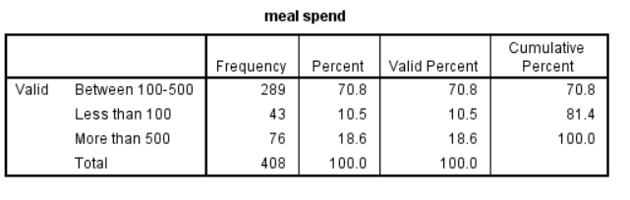
Meal Spending Patterns
Key Findings:
Most people (around 71%) spend between 100-500 per fast food meal, indicating that this is the typical price range for fast food consumption.
A smaller segment (18.63%) spends more than 500, possibly due to ordering premium or larger meals.
Only about 10.54% spend less than 100, which suggests that affordable fast food options are less common or less preferred

Slide 56
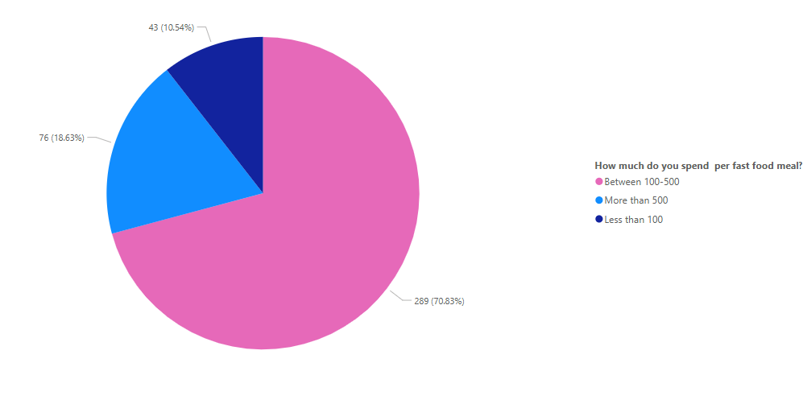

Slide 57
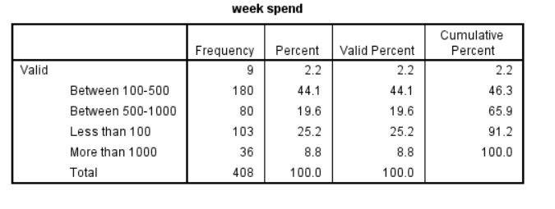
Weekly Spending Patterns
The most common range for weekly spending is ₹100 to ₹500 (43.4%), which aligns with the findings on meal spend, indicating consistent spending habits within this moderate range.
A significant portion (14.2%) spends less than ₹100 weekly, potentially reflecting individuals with limited budgets or minimal spending needs.
Only 8.7% spend over ₹1000, marking this as the least common category, likely representing higher income earners or those with greater disposable income

Slide 58
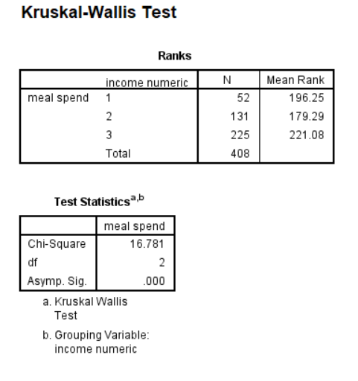
Kruskal-Wallis test : to compare spending across income groups
Group 1 =“Above 80000” Group 2=“Below 15000” Group 3=“15000-80000”
Conclusion:
There is a statistically significant difference in meal spending across the three income groups (p < 0.05).
Income group between 15000-80000 has the highest mean rank (221.08), suggesting this group spends the most on meals.
Income group Below 15000 has the lowest mean rank (179.29), suggesting this group spends the least on meals.

Slide 59
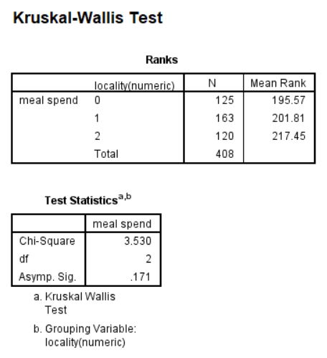
Kruskal-Wallis test : to compare spending across localities
Locality 0=“Urban” Locality 1=“Rural” Locality 2=“semi-urban”
Conclusion:
Based on these results, we can conclude that there is no statistically significant difference in meal spending across the three localities. The p-value of 0.171 is greater than the conventional alpha level of 0.05, meaning we fail to reject the null hypothesis that the meal spending distributions are the same across localities. Despite the mean ranks showing an apparent trend (locality 2 has the highest mean rank at 217.45), this difference is not statistically significant according to the Kruskal-Wallis test.

Slide 60
9. Influence of External Factors Objective: Examine how external influences like social media affect fast food choices.
Chi-Square Test: Check the association between social media influence and fast food consumption frequency.

Slide 61
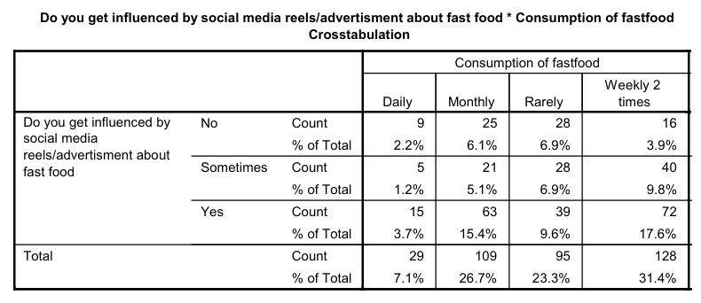
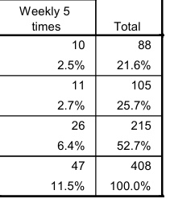
Chi-Square Test
To analyze the relationship between social media influence (via reels/advertisements) and fast food consumption frequency
Key Findings from Crosstabulation:
Respondents who were not influenced by social media mostly consumed fast food rarely or monthly.
Those sometimes influenced showed an increase in weekly and monthly consumption.
Respondents who were influenced had the highest percentage of frequent (weekly and daily) consumption.

Slide 62
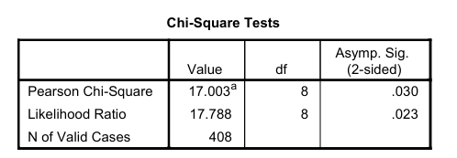
Chi-Square Test Results:
Significance Level (p-value): 0.030
Since p < 0.05, the result is statistically significant, indicating a strong association between social media influence and fast food consumption.
Conclusion:
Social media reels and advertisements significantly influence fast food consumption habits.
Higher exposure leads to more frequent consumption.

Slide 63
CHAPTER 3
Health Awareness And Impact of Fast Food

Slide 64
To ASSESS the awareness And impact of health risks associated with fast food consumption
Frequency analysis
(of reported health changes)
Chi-Square Test:
( Determine the relationship between fast food consumption and self-reported health issues)

Slide 65
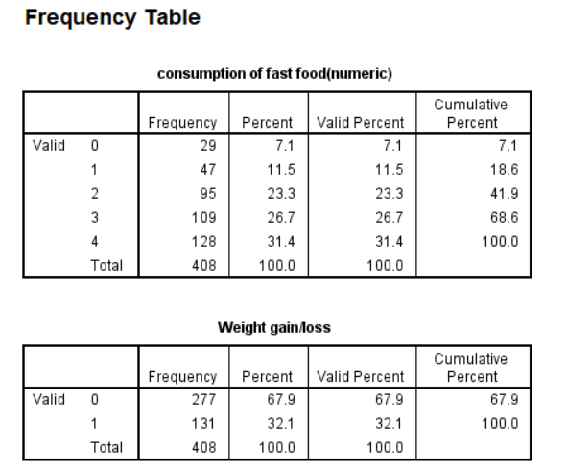
FREQUENCY ANALYSIS
Key Findings:
Among 408 respondents, 32.1% (131 people) reported experiencing weight gain or loss, whereas 67.9% (277 people) did not notice any weight changes.
This suggests that while fast food consumption does not immediately impact weight for the majority, a significant portion of people do experience changes in body weight, possibly due to excess calorie intake and poor nutritional balance.
Fast Food Consumption and Weight
Gain/Loss

Slide 66
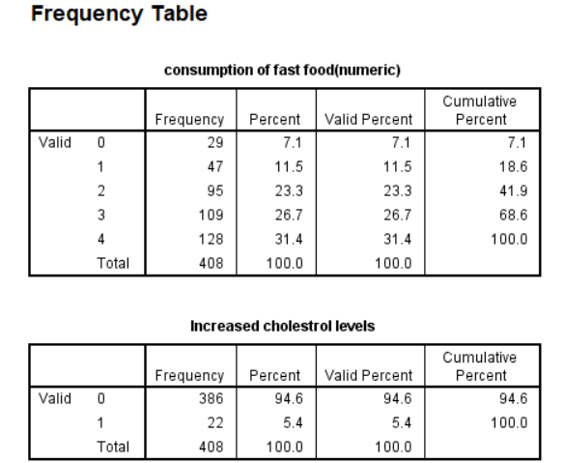
Key Findings:
Out of 408 respondents, 5.4% (22 people) reported an increase in cholesterol levels, while 94.6% (386 people) did not experience any change.
This indicates that while cholesterol increase is not common, those affected might be individuals with pre-existing conditions or those who consume excessive fast food high in unhealthy fats.
Fast Food Consumption and Increased Cholesterol Levels

Slide 67
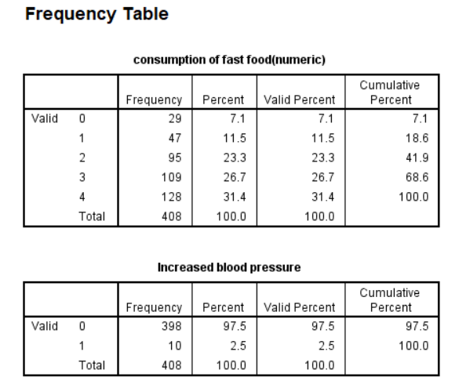
Fast Food Consumption and Increased Blood Pressure
Key Findings:
2.5% (10 people) reported an increase in blood pressure, whereas 97.5% (398 people) did not experience any significant rise in their blood pressure levels.
The low percentage suggests that occasional fast food consumption may not have an immediate impact on blood pressure, but long-term consumption could be a risk factor.

Slide 68
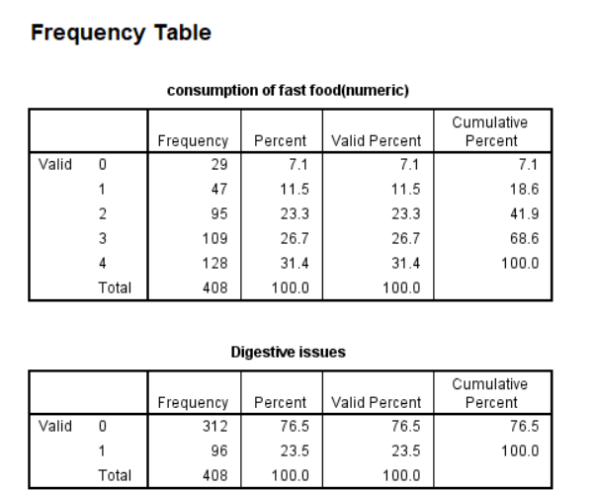
Fast Food Consumption and Digestive Issues
Key Findings:
23.5% (96 people) reported digestive problems, while 76.5% (312 people) did not experience any discomfort.
This suggests that nearly one in four people suffer from digestive issues, possibly due to processed ingredients, high fat content, and low fiber in fast food.

Slide 69
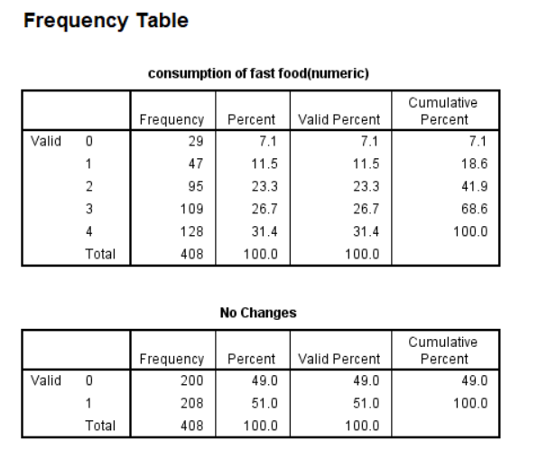
Key Findings:
51.0% (208 people) reported no noticeable changes in their health, while 49.0% (200 people) experienced some form of effect (such as weight gain, digestive issues, or increased cholesterol).
This shows that reactions to fast food consumption vary significantly from person to person, likely depending on metabolism, lifestyle, and frequency of consumption.
Fast Food Consumption and No Noticeable Health Changes

Slide 70
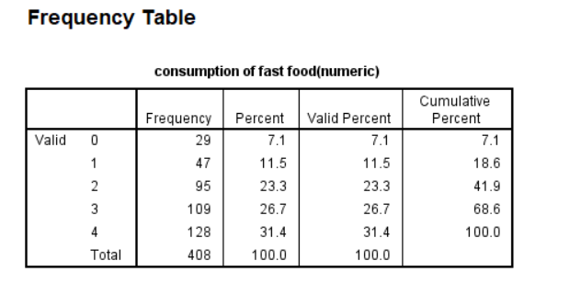
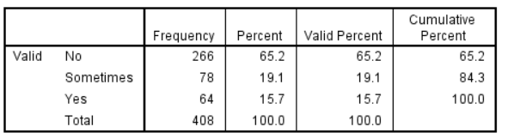
Key Findings:
65.2% (266 people) never experienced foodborne illnesses after consuming fast food.
19.1% (78 people) reported occasional illness, while 15.7% (64 people) frequently suffered from foodborne illnesses.
This suggests that while food safety standards are generally maintained, around 35% of respondents have experienced illness, which raises concerns about hygiene and food handling in fast food establishments.
Fast Food Consumption and Foodborne Illnesses
Foodborne illnesses

Slide 71
Awareness and Health Impact Assessment(old age)
1.Chi-square tests - To analyze associations between:
Health risk awareness and health status
Consumption frequency and specific health issues reported

Slide 72
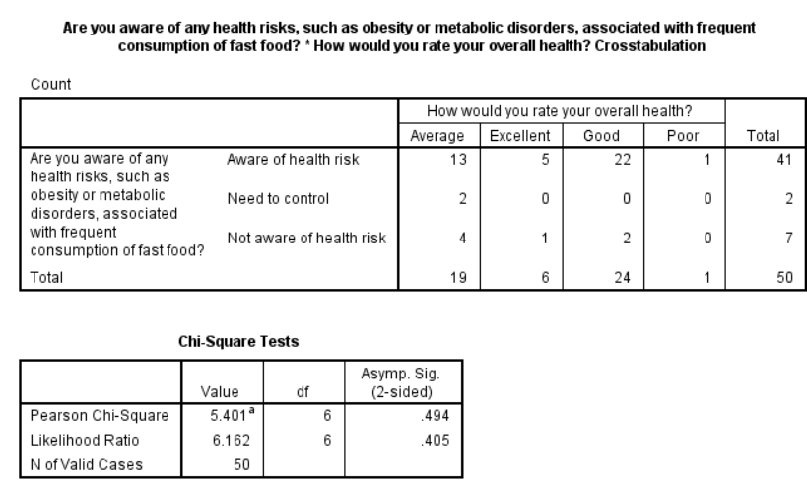
Chi-square test
Health risk awareness and health status
Key observations:
Out of 50 total respondents, 41 (82%) were aware of health risks associated with fast food consumption
Most respondents (24 or 48%) rated their health as "Good"
Of the 41 people aware of health risks, the majority (22) rated their health as "Good"
Very few respondents (only 7) reported being "Not aware of health risk"
Only 2 respondents indicated they "Need to control" health risks
Conclusion:
Since the p-value (0.494) is greater than the conventional significance level of 0.05, we fail to reject the null hypothesis. This means there's no statistically significant association between awareness of fast food health risks and self-rated overall health.

Slide 73
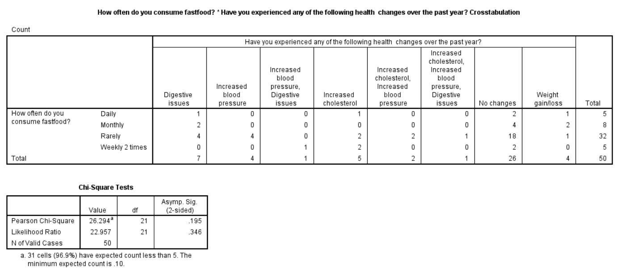
Chi-square
Consumption frequency and specific health issues reported
Key Findings:
The table shows the most individuals who consume fast food rarely reported no health changes
The chi-square test result reveal no statistically significant association between fast food consumption frequency and health changes:
Pearson chi-square p-value:0.195
Likleyhood ratio p-value:0.346
Both p-values are greater than the common significance level of 0.05 ,indicating a lack of significance
Conclusion:
The data suggests that there is no clear link between how often individuals consume fast food and the health changes they experience.

Slide 74
To explore the relationship between Body Mass Index (BMI) and fast food consumption
ONE WAY ANOVA
(To compare BMI across 5 different fast food consumption groups)

Slide 75



ONE WAY ANOVA
Body Mass Index (BMI) AND fast food consumption
The analysis compared BMI across 5 different fast food consumption groups (labeled 0-4):
0=“Daily” 1=“Weekly 5 times” 2=“Rarely” 3=“Monthly” 4=“Weekly 2 times”
Group 0: 29 participants, Mean BMI = 23.39, SD = 4.36
Group 1: 47 participants, Mean BMI = 19.26, SD = 4.92
Group 2: 95 participants, Mean BMI = 20.70, SD = 5.20
Group 3: 109 participants, Mean BMI = 19.81, SD = 4.67
Group 4: 128 participants, Mean BMI = 21.15, SD = 4.18
Overall mean BMI = 20.63, SD = 4.75
Significance (p-value) = 0.214
Interpretation: The assumption of homogeneity of variances is met (p > 0.05), indicating that the variances across groups are not significantly different. This strengthens the validity of the ANOVA results.

Slide 76


ANOVA Results:
Significance (p-value) = 0.001
Interpretation: There is a statistically significant difference in BMI between at least two of the fast food consumption groups.
Homogeneous Subsets:
The analysis identified two overlapping subsets:
Subset 1: Groups 1, 3, 2, and 4 (with mean BMIs of 19.26, 19.81, 20.70, and 21.15)
Subset 2: Groups 4 and 0 (with mean BMIs of 21.15 and 23.39)
Group 4 appears in both subsets, indicating it's not significantly different from either the lower BMI groups or Group 0.

Slide 77


Post-Hoc Tests (Tukey HSD)
The post-hoc analysis showed specific differences between groups:
Significant differences:
Group 0 vs. Group 1: Mean difference = 4.13, p = 0.002
Group 0 vs. Group 3: Mean difference = 3.58, p = 0.002
Nearly significant difference:
Group 0 vs. Group 2: Mean difference = 2.69, p = 0.053 (just above the significance threshold)
Non-significant differences (p > 0.05) were found between:
Group 0 vs. Group 4
All other group comparisons

Slide 78
Overall Interpretation:
The results indicate that BMI differs significantly based on fast food consumption patterns. Specifically:
Group “Daily” shows significantly higher BMI values compared to Groups 1 and 3.
The mean BMI progresses in this order: Group 1 (19.26) < Group 3 (19.81) < Group 2 (20.70) < Group 4 (21.15) < Group 0 (23.39).
The pattern suggests that more frequent fast food consumption (Group 0) is associated with higher BMI, while less frequent consumption patterns show lower BMI values.
All group means fall within the "normal weight" BMI category (18.5-24.9), though Group 0 is approaching the upper boundary.
This analysis provides statistical evidence for a relationship between fast food consumption frequency and BMI in your sample, with the highest consumption frequency group showing significantly higher BMI values than some of the lower consumption groups.

Slide 79
CHAPTER 4
Evaluating Fast Food Satisfaction

Slide 80
To evaluate satisfaction levels (younger adults)
Median test
(To examine the relationship between age and satisfaction with current fast food consumption habits and To examine the relationship between occupation and satisfaction with the quality of fast food in local outlets)

Slide 81

to examine the relationship between age and satisfaction with current fast food consumption habits
Conclusion:
The p-value (0.000) is less than 0.05, indicating a statistically significant relationship between age and satisfaction with fast food consumption habits.
This suggests that satisfaction levels vary significantly across different age groups.

Slide 82

TO examine the relationship between occupation and satisfaction with the quality of fast food in local outlets
Conclusion:
The p-value (0.000) is less than 0.05, indicating a statistically significant relationship between occupation and satisfaction with fast food quality.
This suggests that satisfaction levels vary significantly across different occupational groups.

Slide 83
Satisfaction Level Evaluation
Mann-Whitney U - To compare satisfaction ratings across demographic groups (since satisfaction is measured on an ordinal scale)
Correlation Analysis - To examine relationships between:
Satisfaction with hygiene and satisfaction with quality
Satisfaction with hygiene and frequency of consumption

Slide 84

Hygiene and cleanliness standards of fast food outlets
Mean Rank:
Gender 0: 27.72
Gender 1: 21.56
Mann-Whitney U = 217.000, p = 0.129 (not significant)
Quality of fast food in local outlets
Mean Rank:
Gender 0: 24.67
Gender 1: 26.97
Mann-Whitney U = 261.500, p = 0.567 (not significant)
Interpretation:
Since p-values (0.129 and 0.567) are greater than 0.05, there is no significant difference
between the two gender groups in their perceptions of hygiene/cleanliness and quality of fast food outlets.
Mann-Whitney U Test: Gender Differences in Fast Food Perceptions

Slide 85

Correlation(Non-parametric) Between Perceptions of Hygiene and Quality in Fast Food Outlets
Spearman’s Rho (Nonparametric)
Correlation coefficient (ρ) = -0.444
p-value = 0.001 (significant at the 0.01 level)
Interpretation:
The nonparametric
test confirms the moderate negative correlation
seen in Pearson’s test.
Overall Conclusion
There is a significant negative correlation between
perceptions of hygiene/cleanliness and quality of fast food.
This suggests that individuals who
rate hygiene and cleanliness higher tend to
rate the quality of fast food lower.

Slide 86

Correlation Between Hygiene Perception and Fast Food Consumption
Spearman's Rank Correlation (Nonparametric)
Correlation between hygiene perception and
fast food consumption:
Spearman's correlation coefficient = 0.262
Significance (p-value) = 0.066
Interpretation:
The correlation is weaker compared to Pearson’s
and is not statistically significant at the 0.05 level. This suggests that when
using rank-based correlation (for non-normally distributed data), the relationship is less clear

Slide 87
Conclusion
The Spearman correlation suggests a weak, non-significant relationship, meaning the relationship might not be as strong when considering nonparametric assumptions.
If data violates normality assumptions, Spearman’s rho is more reliable, and it suggests the relationship might not be statistically significant.

Slide 88
CHAPTER 5
Quality analysis

Slide 89
Understand how often people monitor their calorie/nutritional intake and its relationship with other factors
Descriptive Statistics: Calculate the frequency and percentage of respondents who always, sometimes, or never monitor their nutritional intake.
Chi-Square Test: Analyze the association between nutritional awareness and factors like age group, income level, or fast food consumption frequency.

Slide 90
Descriptive Statistics for Nutritional Awareness
We have analyzed how often people monitor their nutritional value/calorie intake from fast food meals.
Here’s what the data shows:
8.82% of respondents "Always" monitor their nutritional intake.
This means only a small portion of the population is highly conscious of tracking their food's nutritional value.
49.51% "Never" monitor their nutritional intake.
Nearly half of the respondents do not check or care about their calorie/nutritional intake at all.
41.67% "Sometimes" monitor their nutritional intake.
A significant percentage of people occasionally check their nutrition but are not consistent in doing so.
Key Takeaways:
The majority (91.18%) are not fully committed to tracking their nutritional intake.
Only a small group (8.82%) is actively monitoring their nutrition every time they eat fast food.
This could indicate low awareness about the importance of nutrition or a lack of concern about health risks related to fast food consumption.

Slide 91

CHI-SQUARE TEST
Relationship Between Age and Monitoring of Fast Food Nutritional Value
Summary:
A chi-square test was conducted to examine the association between age groups and monitoring the nutritional value of fast food meals.
The results indicate a significant relationship (χ²(4) = 15.946, p = .003), suggesting that younger individuals are more likely to track nutritional information compared to older age groups.

Slide 92


Summary:
A chi-square test was conducted to examine the association between fast food consumption frequency and monitoring nutritional value.
The results indicate a statistically significant relationship (χ²(8) = 15.917, p = .044), suggesting that individuals who consume fast food less frequently are more likely to monitor its nutritional content compared to those who eat it more frequently.
Relationship Between Fast Food Consumption and Monitoring Nutritional Value

Slide 93

Relationship Between Locality and Monitoring of Fast Food Nutritional Value
Summary:
A chi-square test was conducted to examine the association between locality (rural, semi-urban, urban) and monitoring the nutritional value of fast food meals.
The results (χ²(4) = 5.722, p = .221) indicate no significant relationship, suggesting that locality does not significantly influence whether individuals monitor the nutritional content of their fast food meals.

Slide 94


Relationship Between Occupation and Monitoring of Fast Food Nutritional Value
Summary:
A chi-square test was conducted to examine the association between occupation and monitoring the nutritional value of fast food meals.
The results (χ²(4) = 7.578, p = .108) indicate no statistically significant relationship. This suggests that occupation does not significantly influence whether individuals monitor the nutritional content of their fast food meals.

Slide 95

Relationship Between Gender and Monitoring of Fast Food Nutritional Value
Summary:
A chi-square test was conducted to determine if there is a significant relationship between gender and monitoring the nutritional value of fast food meals.
The results (χ²(2) = 3.228, p = .199) indicate no statistically significant association. This suggests that gender does not significantly influence whether individuals monitor the nutritional content of their fast food meals.

Slide 96

Relationship Between Household Income and Monitoring of Fast Food Nutritional Value
Summary:
A chi-square test was conducted to examine the relationship between household income and monitoring the nutritional value of fast food meals.
The results (χ²(4) = 2.140, p = .710) indicate no statistically significant association. This suggests that household income does not significantly influence whether individuals monitor the nutritional content of their fast food meals.

Slide 97

Relationship Between District and Monitoring of Fast Food Nutritional Value
Summary:
A chi-square test was conducted to examine the association between district (Calicut vs. Malappuram) and monitoring the nutritional value of fast food meals.
The results (χ²(2) = 5.757, p = .056) suggest a marginally non-significant association. This indicates that while there might be some differences in monitoring habits between the two districts, the relationship does not reach statistical significance at the conventional 0.05 level.

Slide 98
Foodborne Illnesses & Health Impacts
Chi-Square Test: Determine the relationship between fast food consumption frequency and reported foodborne illnesses.

Slide 99

Fast Food Consumption and Foodborne Illness
Crosstabulation Overview:
The table examines the relationship between fast food consumption
frequency and whether individuals have experienced foodborne illness from fast food.
The majority (30 out of 50) of respondents rarely consume fast food, and most of them reported no foodborne illness.
A small number of respondents reported experiencing foodborne illness (either "Yes" or "Sometimes"),
with the highest count (3 out of 50) found among those who consume fast food monthly or rarely.

Slide 100

Chi-Square Test Results:
Significance (p-value) = 0.163
Since p > 0.05, the result is not statistically significant, meaning there is
no strong evidence of a relationship between fast food consumption frequency and reported foodborne illness.
Likelihood Ratio Test:
Likelihood Ratio = 10.682, with a p-value of 0.099, which is still not significant at the 0.05 level.
Conclusion:
The analysis suggests that there is no statistically significant association between how
often a person consumes fast food and whether they report experiencing foodborne illness.
While some individuals who eat fast food frequently report illness, the variation could be due to chance rather than a meaningful pattern.
A larger sample size or additional variables (such as food safety awareness) might help explore this relationship further.

Slide 101
Consumer satisfaction with fast food quality
1.Descriptive statistics::
(Compute mean, median, and mode of satisfaction ratings)
2.Welch ANOVA:
(Compare satisfaction levels across different locality and income groups)
3.ANOVA
(Compare satisfaction levels across different Locality)

Slide 102

Descriptive statistics
0=“very satisfied” 1=“very unsatisfied” 2=“unsatisfied” 3=“satisfied” 4=“neutral”
Key findings:
This interpretation, the results indicate that nearly half of respondents (48.5%) expressed a neutral opinion about fast food quality.
Equal numbers of respondents (20.3% each) reported being either satisfied or unsatisfied. Only a small percentage were at the extremes, with 4.4% being very satisfied and 6.4% being very unsatisfied.
This suggests most people have either neutral or mixed feelings about fast food quality, with the largest group not feeling strongly either way.

Slide 103

WELCH ANOVA
Compare satisfaction levels across different income groups group1-above 80,000 , group 2-below 15,000 ,
group3- between 15,000-80,000.
KEY FINDINGS:
Statistical Significance
The p-value (0.003) is less than the standard significance level of 0.05
This indicates statistically significant differences in satisfaction with fast food quality across groups
Robust Confirmation
The Welch test (p-value = 0.004) further confirms the finding of significant differences between groups
Conclusions:
There is a statistically significant difference in satisfaction with the quality of fast food across the groups.
Different demographic or customer segments have notably different perceptions of fast food quality
These variations might be due to factors like age, preferences, expectations, or specific outlet characteristics

Slide 104

Conclusion:
The Games-Howell post-hoc test reveals significant differences in fast food satisfaction between income groups. Specifically:
Income Group 1 reports significantly higher satisfaction than both Group 2 (p=0.040) and Group 3 (p=0.020).
There is no significant difference in satisfaction between Income Groups 2 and 3 (p=0.611).
These findings suggest that respondents in the higher income category are more satisfied with fast food quality in local outlets compared to respondents in lower income categories. This could potentially indicate different expectations or standards for fast food quality across income levels, with higher income groups possibly being more critical of fast food quality.

Slide 105

ANOVA
Compare satisfaction levels across different LOCALITY
0=“urban” 1=“rural” 2=“semi-urban”
From the ANOVA results:
F(2, 405) = 2.124, p = 0.121
Since the p-value (0.121) is greater than the conventional significance level of 0.05, we fail to reject the null hypothesis.
This means there is no statistically significant difference in fast food satisfaction ratings among the three groups. While there appear to be small differences in the mean satisfaction scores (with Group 1 having the highest mean at 3.12), these differences are not statistically significant and could be due to random sampling variation.

Slide 106
CHAPTER 6
ViSUALIZATIONS

Slide 107

choose healthier food options over fast food
Key findings:
78% of respondents (Sometimes + Always) make healthy food choices to some degree
Only about 10.4% completely ignore healthier food options
There's a mixed approach to nutrition, with most people being occasional or consistent healthy eaters

Slide 108

Consumption of beverages like soda or milkshake with fast food
Key insights:
There's a slight preference for consuming sugary beverages with fast food
The split is relatively close, with just an 11.28% difference between those who do and do not drink soda or milkshakes
Suggests a fairly balanced attitude towards beverage choices when eating fast food

Slide 109

Social media influence on fast food consumption
Conclusion:The majority of respondents, especially males, are influenced by social media advertisements regarding fast food. Fewer people remain unaffected, with females showing a slightly higher resistance compared to males

Slide 110

SATISFACTION WITH FAST FOOD HABITS
Key insights:
Most respondents (198) are neutral about their fast food consumption
More people are satisfied (111) than unsatisfied (59)
Only a small number have extreme views (13 very satisfied, 27 very unsatisfied)

Slide 111
CONCLUSION
Fast food consumption varies across demographic variables, with middle-income individuals consuming it more frequently, rural areas experiencing more health-related issues, and males showing a slightly higher but statistically insignificant tendency to consume fast food compared to females.
Taste is the primary motivator for fast food consumption across all demographics, with males and students being more influenced by habit, younger adults (21-30) prioritizing taste and social media influence, higher-income individuals focusing less on cost, and urban consumers being less driven by cost and habit.
Middle Eastern and Indian fast foods, particularly Alfaham, Mandi, and Shawarma, are the most preferred choices across demographics,while traditional Western fast foods like burgers and pizza rank significantly lower in preference. Malappuram had a higher liking for Alfaham, Shawarma, and Fried Chicken, while Calicut slightly preferred Mandi.
Dinner is the most preferred time for fast food consumption, followed by the evening, while breakfast has minimal demand, with young adults (21-30) showing the highest preference for evening and dinner fast food.

Slide 112
People generally spend a moderate to high amount on fast food, with most meal expenses falling between ₹100-500 and weekly spending following a similar pattern. Spending varies significantly by income level but not by locality.
While fast food consumption does not immediately impact weight or cholesterol for most people, it can contribute to weight changes, digestive issues, and foodborne illnesses, with long-term risks for blood pressure, though individual reactions vary based on metabolism, lifestyle, and frequency of consumption.
Satisfaction levels with fast food consumption vary significantly across different age and occupational groups.
Higher fast food consumption frequency is statistically associated with higher BMI, though all groups remain within the normal weight range, with the highest consumption group nearing the upper boundary.
Social media significantly influences the frequency of fast food consumption, with higher exposure leading to more frequent intake, but it does not have a strong or direct impact on expenditure.

Slide 113
Nutritional awareness is generally low, with 91.18% of individuals not consistently tracking their nutritional intake. Younger individuals and those who consume fast food less frequently are more likely to monitor its nutritional value. However, factors such as locality, occupation, gender, household income, and district do not show significant influence on nutritional monitoring habits.
There is no statistically significant association between fast food consumption frequency and reported foodborne illnesses, though some individuals who frequently consume fast food do report illness, which may be influenced by other factors.
Consumer satisfaction with fast food quality varies across income groups, with higher-income consumers showing higher satisfaction, while there is no statistically significant difference in satisfaction based on locality.

Slide 114
OLD AGE OUTCOMES
Fast food consumption patterns, including weekly spending and meal timing, do not significantly differ based on gender, age, occupation, or location, indicating relatively uniform eating habits across these demographics.
Fast food consumption is primarily driven by taste, brand perception, and habit across age groups, with older individuals valuing habit and brand, while younger consumers are more influenced by social media and special offers.
There is no significant relationship between fast food consumption frequency and health awareness, self-rated health status, or reported health issues.
There is no significant difference in fast food perceptions between genders. A significant negative correlation exists between hygiene perceptions and quality ratings, meaning those who perceive better hygiene tend to rate food quality lower.

Slide 115
THANK YOU

